Slide 1

Preliminary Matters
This training is presented by Gilbert Training Group (GTG), LLC. GTG holds the copyright to these materials & any use requires express, written permission from GTG.
Nothing in this session is intended to be legal advice nor does it establish an attorney-client relationship. Law & regulations vary by state and if you seek legal advice it should be specific to your state and circumstances.
Add presenter photo
Advanced Bargaining · Union Training

Slide 2
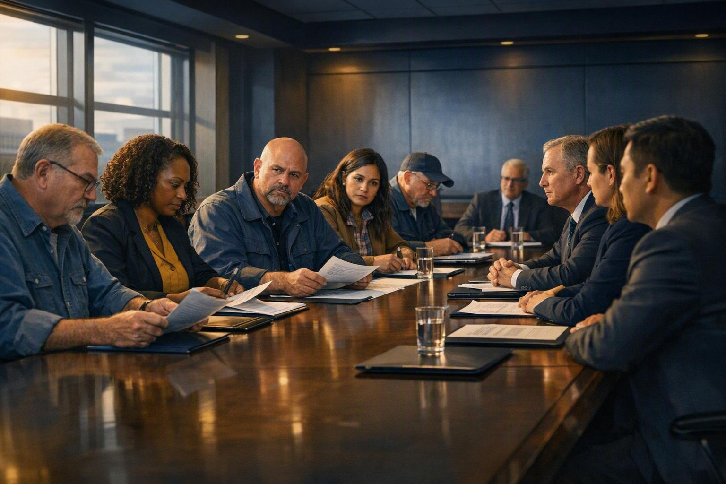
Union Collective Bargaining Negotiations
ADVANCED TRAINING
A working session for union leaders & negotiators
Strategy & Tactics · Leverage · Health Care · Common Pitfalls

Slide 3
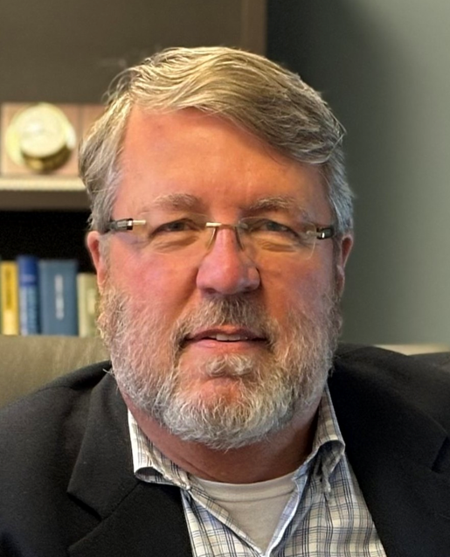
David Borer
YOUR PRESENTER
Attorney
Qualifications
45 yrs. in union negotiations
Federal, state & private sector
Hundreds of major public and private sector contracts
Of Counsel at Gilbert Employment Law, PC
Bar Admission: Ohio
Add presenter photo
Advanced Bargaining · Union Training

Slide 4
What this session covers
MODULE 01 · LEGAL FRAMEWORK
1
2
3
4
Strategy & Tactics
Leverage
Health Care
Common
Pitfalls
›
›
›
Negotiation require strategic planning & flexibility
How to develop it,
how to use it
Mistakes & traps to avoid for a successful negotiations
Often the toughest issue & one that requires special attention
Why these issues matter: Negotiations are an exercise in strategy and power. Preparation is always key, but since many school-employee units cannot legally strike, so we must look for leverage in other way.
Advanced Bargaining · Union Training
08

Slide 5
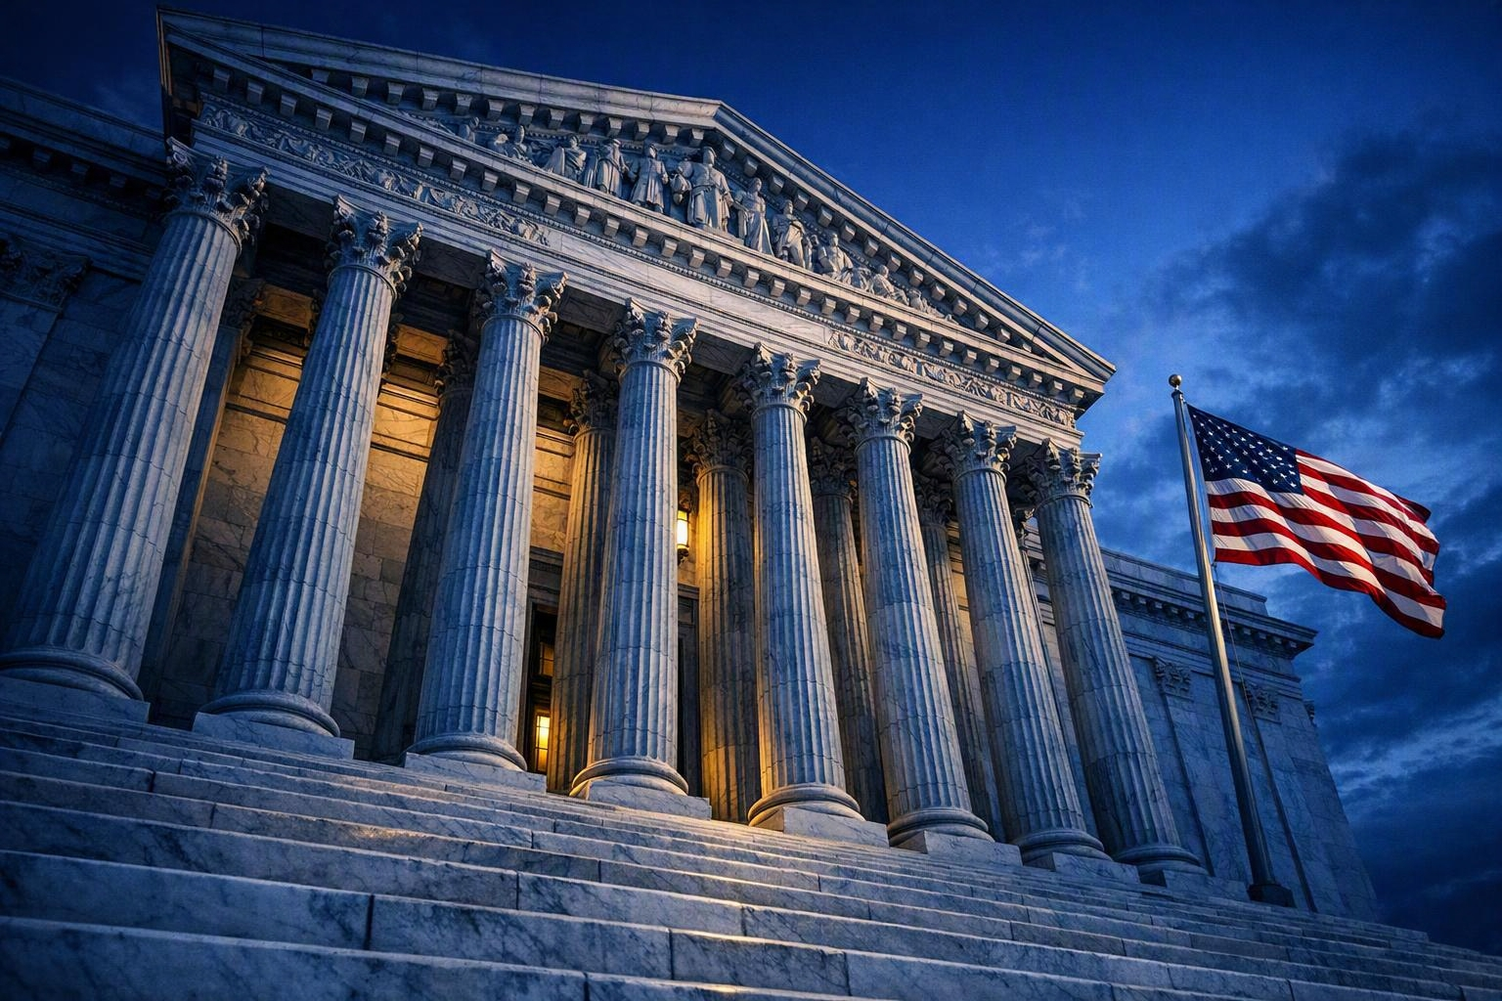
FIRST: KNOW THE LEGAL FRAMEWORK
The guard rails for your negotiations.

Slide 6

The Duty to Bargain in Good Faith
LEGAL FRAMEWORK
Indicia of bad-faith bargaining
Surface bargaining — going through the motions with no intent to reach agreement
Unilateral changes to mandatory subjects without bargaining first
Direct dealing — bypassing the union to negotiate with members
Refusing to furnish relevant information the union requests
Regressive proposals used to frustrate, not advance, a deal
Good faith is about conduct, not concession
Both parties must meet at reasonable times and confer in good faith over wages, hours, and terms and conditions of employment. Neither side is required to agree to a proposal or make a concession.
Exact duties vary by state statute and labor board — know the standard in your jurisdiction.
Advanced Bargaining · Union Training
05

Slide 7
What You Can — and Can't — Bargain Over
MODULE 01 · LEGAL FRAMEWORK
MANDATORY
PERMISSIVE
PROHIBITED
Must bargain
May bargain if both agree
Cannot bargain
Wages, hours, overtime
Health & pension contributions
Grievance procedure
Layoff, recall & seniority
Health and safety
Broad policy input
Internal union affairs
Some management-rights areas
Terms that conflict with statute
Waiver of statutory rights
Closed-shop terms where barred
“Terms and conditions of employment.”
Neither side may bargain to impasse over these.
Illegal subjects are void even if agreed.
This varies from state to state, so do some research. The classification of a subject is often the real fight — many budgetary and staffing decisions are reserved as management rights.
Advanced Bargaining · Union Training
06

Slide 8

Unfair Labor Practices at the Table
LEGAL FRAMEWORK
Employer ULPs
Union ULPs
Refusing to bargain a mandatory subject
Making unilateral changes mid-bargaining
Direct dealing with members
Retaliation for protected activity
Failing to furnish requested information
Refusing to bargain on a mandatory subject.
Insisting to impasse on permissive or illegal subjects
Coercing members over representation
Unlawful job actions where prohibited
Document everything. A dated, detailed bargaining log is your evidence if you file — or defend against — a charge.
Advanced Bargaining · Union Comittee Training
07

Slide 9
Two Approaches — and When to Use Each
LEGAL FRAMEWORK
Positional
Interest-Based
Distributive · zero-sum
Integrative · problem-solving
Use it when
Best for clearly economic, splittable items — across-the-board wage percentages.
Use it when
Best for complex problems — class size, planning time, workload, and staffing.
Watch out
Hardens positions and can strain the ongoing relationship.
Watch out
Needs trust and skilled facilitation; vulnerable if one side stays positional.
Bottom line: Often school contracts are hybrid — match the method to the issue, table by table.
Advanced Bargaining · Union Training
10

Slide 10
When Talks Stall: Impasse Procedures
LEGAL FRAMEWORK
1
2
3
4
Mediation
Fact-Finding
Interest Arbitration
Legislative / Funding
›
›
›
A neutral helps the parties find their own agreement. Non-binding.
A neutral reviews evidence and issues public, non-binding recommendations.
A neutral or panel imposes contract terms — often binding where strikes are barred.
For some units, the funding body must approve or appropriate the money.
Why it matters: These vary from state to state so know your procedures before you go to the table. Many school-employee units cannot legally strike, so leverage has to be found elsewhere and these procedures take on greater importance.
Advanced Bargaining · Union Training
08

Slide 11

Bargaining
Strategy & Tactics
MODULE 01
Leverage is built long before the first session — and spent carefully once you're at the table.

Slide 12

Strategy: At the Table & Away from the Table
Both are important and must work together
MODULE 01 · STRATEGY & TACTICS
Table Tactics
Bargaining Notes – detailed, dated bargaining log
Organize the Process – Take time at the start to plan how proposals will be done and recorded
Deadline Pressure – Don’t let an artificial clock force a deal
Take it or Leave it – Don’t say it if you don’t mean it
Splitting the Committee – Use it, don’t fall for it
Regressive Bargaining – Call it out when management does it. Consider ULP
Tactical SILENCE!
One spokesperson – everyone else takes notes
Speak for the Members – you represent them & know what they want
Caucus – early and often; never decide at the table
Stay cool – never react to a first offer
Set ground rules – how negotiations will work
Credibility – consistency, honesty, reliability
Advanced Bargaining · Union Training
13

Slide 13

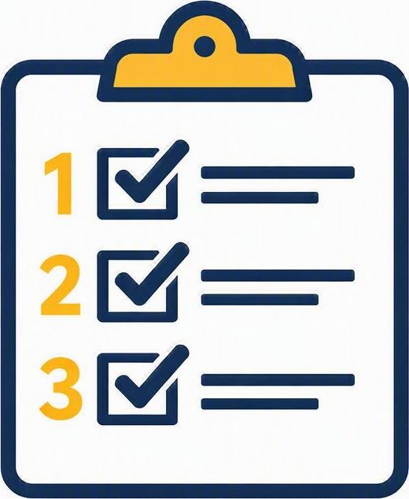
Building and Sequencing Your Proposals
MODULE 01 · STRATEGY & TACTICS
01
02
03
04
05
Know your Priorities
Cost it first
Draft the language
Sequence with intent
Package, don't pick
Never make a proposal you haven't priced — for you and for the employer.
Propose the actual contract clause, not a vague wish or a concept.
Move items in linked packages so every trade is visible and deliberate.
Separate must-haves from trade-bait. Let the membership survey set the priorities.
Open with non-economic items to build momentum; hold economics for later.
You’ll feel more in control of the process if you prepare thoroughly & follow through..
Advanced Bargaining · Union Training
12

Slide 14




Timing & Preparation
MODULE 01 · STRATEGY & TACTICS
Preparations
Numbers
Start your prep early to be sure you have time for survey, member meetings, drafting proposals, etc
Review school budget and revenue figures and an overview of headcount and payroll costs
Scheduling Talks
Brainstorm
If you have a hard deadline, work backwards from there to schedule sessions to finish by the deadline.
Before negotiations begin leadership & negotiating committee should meet to brainstorm and get on the same page.
Advanced Bargaining · Union Training
15

Slide 15

Outside Strategy
What happens away from the table is often the most imporant
MODULE 01 · STRATEGY & TACTICS
Outside Strategy
Power Structure Analysis → Analyze the pressure points for school district management
Community Outreach → Build coalitions within the community and the labor movement
Media Strategy → Develop media relations and interest them in negotiations
Political Support → Build relationships with key politicians, School Board members, etc
Polling & Meetings → Listen and talk to the members enlist them in the process
Enlist the Members → They have a role and they cannot be allowed to feel left out
Escalating Solidarity Actions → Activate the members to greater and greater involvement
Advanced Bargaining · Union Committee Training
13

Slide 16

Leverage
MODULE 02
Talk happens at the table – leverage happens away from the table.

Slide 17


Slide 18

Know Your Leverage Before You Sit Down
MODULE 02 · LEVERAGE
Solidarity & density — A united, mobilized, high-density membership is your foundation of power.
1
Community & political support — parents, community allies, and school-board friends are leverage.
2
Five sources of union power
Information — The employer's budget, comparables, and established past practice.
3
Timing — Budget and levy cycles, school-board elections, the school calendar, and contract expiration.
It’s only potential power until you turn it into action. That’s why they call it the Labor Movement.
4
Your alternatives — Your BATNA — and what failing to reach agreement costs each side.
5
Advanced Bargaining · Union Training
11

Slide 19

Mobilizing the Membership
MODULE 02 · LEVERAGE
Map the membership — Chart every worksite so you can reach each member quickly.
1
Contract action team — Recruit one volunteer organizer for roughly every ten members to move information and turnout.
2
An organized membership is power
Escalating actions — Build from buttons and stickers to petitions, rallies, and worksite actions as talks progress.
3
Survey and set priorities — Poll members early so proposals reflect what they will actually fight for.
“Solidarity is a force stronger than gravity – it lifts us up.”
-- Sara Nelson
4
Show participation — Track turnout and report it — visible numbers are the pressure management feels.
5
Advanced Bargaining · Union Training
18

Slide 20

Building Community Coalitions
MODULE 02 · LEVERAGE
Map potential allies — Identify parents, clergy, community groups, and other unions with a stake in the outcome.
1
Lead with shared interests — Frame demands around common goods like staffing and services, not wages alone.
2
Allies widen your leverage
Build standing relationships — Partner with community organizations before you need them, not during a crisis.
3
Coordinate labor solidarity — Work with other locals and the central labor council for turnout and resources.
Management can brush off the union alone; it’s far harder to brush off the whole community.
4
Engage public officials — Cultivate school board members and elected allies who influence the employer.
5
Advanced Bargaining · Union Training
19

Slide 21

Strategic Communications
MODULE 02 · LEVERAGE
Set the core message — Agree on three simple, member-tested messages and repeat them relentlessly.
1
Members first — Keep members ahead of the public through text trees, email, and worksite meetings.
2
Control the narrative
Earned and social media — Pitch reporters and use social channels to reach parents and the community directly.
3
Message discipline — One spokesperson on the record; everyone else stays on the agreed message.
If you don’t define what this fight is about, the employer will define it for you.
4
Rapid response — Answer employer claims quickly with facts before they harden into the story.
5
Advanced Bargaining · Union Training
20

Slide 22

Negotiating
Health Care Benefits
MODULE 03
The fastest-growing cost at the table — and the benefit members feel the most.

Slide 23
Single-Payer / Medicare for All
·MODULE 03 - HEALTH CARE
"It makes no sense that Americans spend almost twice as much per capita on healthcare as the people of any other nation.” – Bernie Sanders
"A single-payer, Medicare-for-all system is the most cost-effective, fair and simple way to provide comprehensive, high-quality health care to all Americans.” – Bernie Sanders
Advanced Bargaining · Union Training

Slide 24

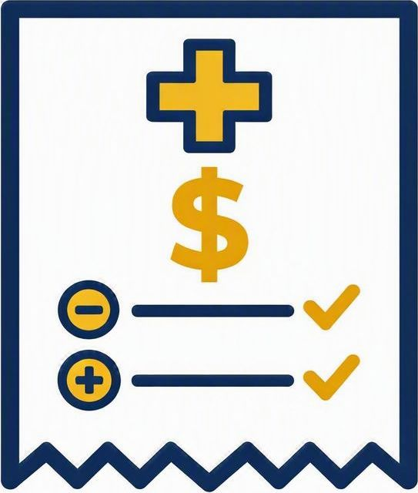


Why Health Care Dominates the Table
·MODULE 03 - HEALTH CARE
Costs outpace wages
Cost-shifting is the play
Premiums routinely rise faster than wages or inflation — an unguarded raise can be swallowed by a rising cost-share.
Higher premium shares, deductibles, and copays move cost onto members.
A major budget pressure
Every dollar is contested
Active and retiree health are among the largest long-term liabilities school districts and states cite.
Health savings you concede become money the employer targets elsewhere — defend the whole package.
Advanced Bargaining · Union Training
19

Slide 25



The Levers You Actually Bargain
·MODULE 03 - HEALTH CARE
Premium cost-share
Deductibles & copays
Plan design & tiers
The employer/employee split of the monthly premium — bargain a percentage, not a flat dollar.
Deductibles, copays, coinsurance, and the out-of-pocket maximum members actually pay.
PPO, HMO, and HDHP + HSA options and the tier structure offered to members.
Provider network
Eligibility & coverage
Opt-out & incentives
Broad versus narrow networks — member access and choice weighed against cost.
Dependents, spouses, part-time, and retiree eligibility and waiting periods.
Opt-out payments, wellness incentives, and HSA / HRA employer contributions.
Advanced Bargaining · Union Training
20

Slide 26

Common Pitfalls
& How to Avoid Them
MODULE 04
Most losses at the table are self-inflicted — know the traps before you sit down.

Slide 27






Six Traps That Sink Bargaining Teams
MODULE 04 · COMMON PITFALLS
Skipping the homework
Members first
Taking the bait
Entering talks without costed proposals or comparables lets the district control the talks. Research first.
Make sure your proposals address members’ needs and that they make sense.
Management may provoke to force concessions or split the team. Stay calm and stick to the plan.
Fracturing solidarity
Letting the clock win
Mixed messages
Public disagreements and side deals hand the district leverage. Members win when we hold together.
There’s always time to make a bad deal. Manage the timeline; don't let it manage you.
When the union speaks w/ many voices, management picks the weakest. Agree the message, then speak as one.
Advanced Bargaining · Union Training
23

Slide 28
My list of worst mistakes
MODULE 04 · COMMON PITFALLS
1.
Getting out of sync with members
2.
Time value of money
3.
Ratification becomes referendum
It’s easy to go off on a tangent that the members have no interest in. Corollary: never stand betw/ members & money.
If prolonging the negotiations delays a pay raise you have to account for the lost wages.
Members don’t get to vote on how you run the union, so they’ll make dissatisfaction known in ratification vote.
4.
Playing the cost game
5.
Failure to enforce
6.
Don’t miss the window
It’s often a mistake to buy into management’s game on costs. Demand what the members want.
In prep for negotiations you may identify issues that were already covered but not enforced. Grieve, don’t renegotiate.
Timing is often a huge factor. Keep an eye on external events and make your deal at the most advantageous time.
Advanced Bargaining · Union Training
23

Slide 29
Key Takeaways
KEY TAKEAWAYS
1
Know your legal rights Bargain the mandatory subjects, classify carefully, and document everything.
2
Prepare relentlessly Preparation is leverage — every proposal researched and costed.
3
Organize the membership A mobilized, united unit is what wins the contract.
4
Build leverage Leverage is the engine that drives the negotiations.
5
Communicate strategically Good internal & extermal communications are vitally important
Advanced Bargaining · Union Training

Slide 30
Questions?
QUESTIONS & DISCUSSION
Let's talk through your toughest issues.

