Slide 1


DON’T BREAK
THE LINK
Build a retiree chapter that keeps members connected, active, and powerful.
Cheryl Holder Lee
President UASF Emeritus
(San Francisco)
Mark Brodsky
CSA Retiree Chapter Director
AFSA Local Leaders Presentation
Notes:
Open with the core message: retirement should not be the end of union membership. Retirees carry history, relationships, political power, and time. The question for local leaders is not whether retirees matter; it is whether your local is organized enough to keep them connected.

Slide 2
“Retirees are not a liability. They are an untapped resource”
Jill Levy, CSA President 2000-2006
AFSA President 2006-2009

Slide 3
The case for a retiree chapter
Retirees are not “former members.” They are the continuity of the union.
When retirees leave the structure, the local loses:
Institutional memory
Who fought for what, why it mattered, and how we won.
Political reach
Retirees vote, organize, lobby, and live in communities across the country.
Member trust
A bridge from active service to retirement, benefits, and advocacy.
Union identity
A visible reminder that membership is lifelong, not transactional.
Bottom line: Retirees are a strategic asset.
AFSA Local Leaders • Retiree Chapter Blueprint
02
Notes:
Make the argument directly. Local leaders are busy and are naturally focused on in-service members. The point is that a retiree chapter strengthens in-service work: political protection, benefits advocacy, historical knowledge, and community presence.

Slide 4

CSA Retiree Chapter: proof that it works
A national footprint built from one local’s decision to keep retirees linked.
10,902
44
5
retiree members
states represented
foreign countries
18
120+
regional units across the country
events and activities each year
Recently added Pennsylvania • Looking to reopen California
AFSA Local Leaders • Retiree Chapter Blueprint
03
Notes:
Use the numbers to make the model tangible. This is not a theory. CSA has more than ten thousand retirees, living in forty-four states and five foreign countries, with eighteen units and over one hundred twenty events each year. The unit model keeps members connected even after they move away.

Slide 5
Where we came from
A short history of why structure matters.
1960
1962
1965
1969
1971
UFT formed
CSA began as Council of Supervisory Associations
NYC Board of Education recognized CSA
First comprehensive written contract for supervisors
CSA joined AFL-CIO as AFSA Local 1
The lesson for AFSA locals:
Power grows when groups move from informal connection to formal structure.
AFSA Local Leaders • Retiree Chapter Blueprint
04
Notes:
This slide compresses the history. CSA began as a coalition because supervisors needed leverage. The pattern is important: informal groups can begin the work, but lasting power requires structure, recognition, and a seat at the table.

Slide 6
The retiree chapter turning point
In 2004, CSA made a strategic decision: retirees belong inside the union family.
Before 2004
Unanimous approval
Retirees participated socially and politically, but were not fully integrated into CSA’s formal structure.
The Executive Board created a chapter that could organize, serve, advocate, and grow.
2004 decision
CSA President Jill Levy recognized retirees as an asset and worked to merge RSSA into a new CSA Retiree Chapter.
Recognition turns goodwill into power.
AFSA Local Leaders • Retiree Chapter Blueprint
05
Notes:
Tell this story as a leadership decision, not just an organizational detail. President Jill Levy saw that retirees had time, knowledge, and passion. Instead of keeping them as a separate social association, CSA brought them into the structure.

Slide 7
What formal recognition made possible
A retiree chapter needs both heart and governance.
New dues → better benefits
Weighted vote
Seat at the table
Resources to serve members and build programming.
Minimum of 250 votes for CSA elected officers, adjusted upward by membership.
Special Vice President on the Advisory Committee.
Executive Board representation
Political action program
Retiree voices embedded in union decision-making.
Members organized to advocate for themselves and in-service members.
AFSA Local Leaders • Retiree Chapter Blueprint
06
Notes:
This is the governance slide. Emphasize that local leaders should not start only with social events. A strong retiree chapter has dues, benefits, representation, political voice, and leadership structure. That is what gives retirees dignity and makes the chapter sustainable.

Slide 8
The CSA model: three purposes
A chapter works when members know why it exists.
Political Voice
Benefits & Outreach
Social Connection
Legislative coordinators. Lobbying. PAC contributions. Phone banks, canvassing, and community voting power.
Helping retirees access health, welfare fund, union benefits, updates, and support when they need us.
Dining, theater, book clubs, bridge, mah jongg, tours, opera, Broadway, golf, tennis, and regional gatherings.
The combination is what keeps retirees engaged: purpose, service, and community.
AFSA Local Leaders • Retiree Chapter Blueprint
07
Notes:
Use the three purposes as the blueprint for other locals. The political part matters, but social connection is the doorway. Benefits and outreach are the trust-builder. The strongest chapters do all three.

Slide 9
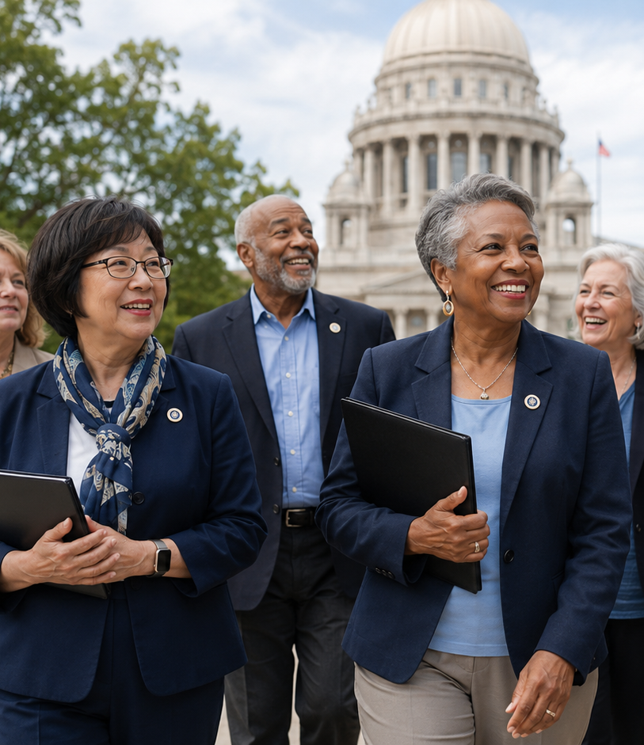
What the chapter does now
A living chapter creates value all year long.
About 120 events a year: dining club, theater club, art walks, tours, opera, Broadway, golf, tennis, mah jongg.
Albany lobbying, City Hall advocacy, AFSA on the Hill, and Labor Day parade participation.
Members contribute to PAC and help with calls, canvassing, and door-knocking when asked.
Regional units host luncheons, dinners, and local events; officers visit whenever possible.
AFSA Local Leaders • Retiree Chapter Blueprint
08
Notes:
This is the proof of life. Retiree chapters cannot just exist on paper. CSA’s chapter is active throughout the year, with social events, political engagement, and regional units. The consistency is what builds culture.

Slide 10
Retirees are a long-term power base
Every age band represents wisdom, service, and connection.
Oldest member: 105
38 members are 100+
13 at age 100 • 6 at 101 • 10 at 102
This is why a retiree chapter must be built to last.
Note: age-band data shown as provided.
AFSA Local Leaders • Retiree Chapter Blueprint
09
Notes:
Use the age bands to show that a retiree chapter is not a one-year project. It must serve new retirees, veteran retirees, and members who remain connected for decades. The oldest CSA retiree member is 105.

Slide 11
The regional unit strategy
Bring the union closer to far-flung members.
18 units
1
Identify a local coordinator
across the country
2
Hold 2–3 meetings per year
Recently added Pennsylvania
Looking to reopen California
3
Invite timely speakers
4
Build a legislative contact list
5
Create social reasons to come back
Local connection creates national reach.
AFSA Local Leaders • Retiree Chapter Blueprint
10
Notes:
Explain that the unit model solves the geography problem. Retirees move. If the chapter stays only at headquarters, it loses people. Units keep members connected in the states where they actually live and vote.

Slide 12
A 90-day blueprint for any AFSA local
Start practical. Build momentum. Formalize as it grows.
Days 1–30
Days 31–60
Days 61–90
Find the champions
Create the first reason to gather
Build the structure
Name a retiree lead. Pull retiree data. Identify 20–50 members who will answer the first call.
Host a lunch, Zoom, benefits briefing, or legislative update. Ask members what they need.
Draft a simple mission, calendar, communication plan, and path to bylaws/representation.
Do not wait for the perfect structure. Start with a real invitation.
AFSA Local Leaders • Retiree Chapter Blueprint
11
Notes:
Give local leaders permission to start small. They do not need ten thousand retirees. They need a champion, a list, a reason to gather, and a plan to turn energy into structure.

Slide 13
What local leaders should commit to
The chapter cannot be an afterthought.
Communicate
Regular emails, newsletters, and updates that make retirees feel remembered.
Represent
Give retirees a meaningful pathway to advise, participate, and be heard.
Serve
Benefits, welfare, health, and retirement support that is easy to access.
Mobilize
Use retiree energy for advocacy, PAC, calls, canvassing, and legislative work.
Celebrate
Social events that turn membership into community.
A retiree chapter is not only a service. It is a relationship.
AFSA Local Leaders • Retiree Chapter Blueprint
12
Notes:
This is the leadership ask. If local leaders want retiree chapters to succeed, they have to communicate, represent, serve, mobilize, and celebrate. Retirees will show up when they see a union that still sees them.

Slide 14

UASF QR Code

Slide 15
Don’t break the link.
Invite retirees back. Give them purpose. Build the chapter.
Leave today with three next steps:
Name your retiree chapter lead.
Schedule one kickoff gathering.
Ask AFSA/CSA for the chapter-start playbook.
Rejoin your union. Stay part of the work.
Notes:
Close with urgency and confidence. Ask local leaders to leave with a practical commitment. Retirement does not end union leadership. It can extend it.

Slide 16
Cheryl Lee cherylholderlee1975@gmail.com
Mark Brodsky
Mbrodsky@CSA-NYC.org

