Slide 1
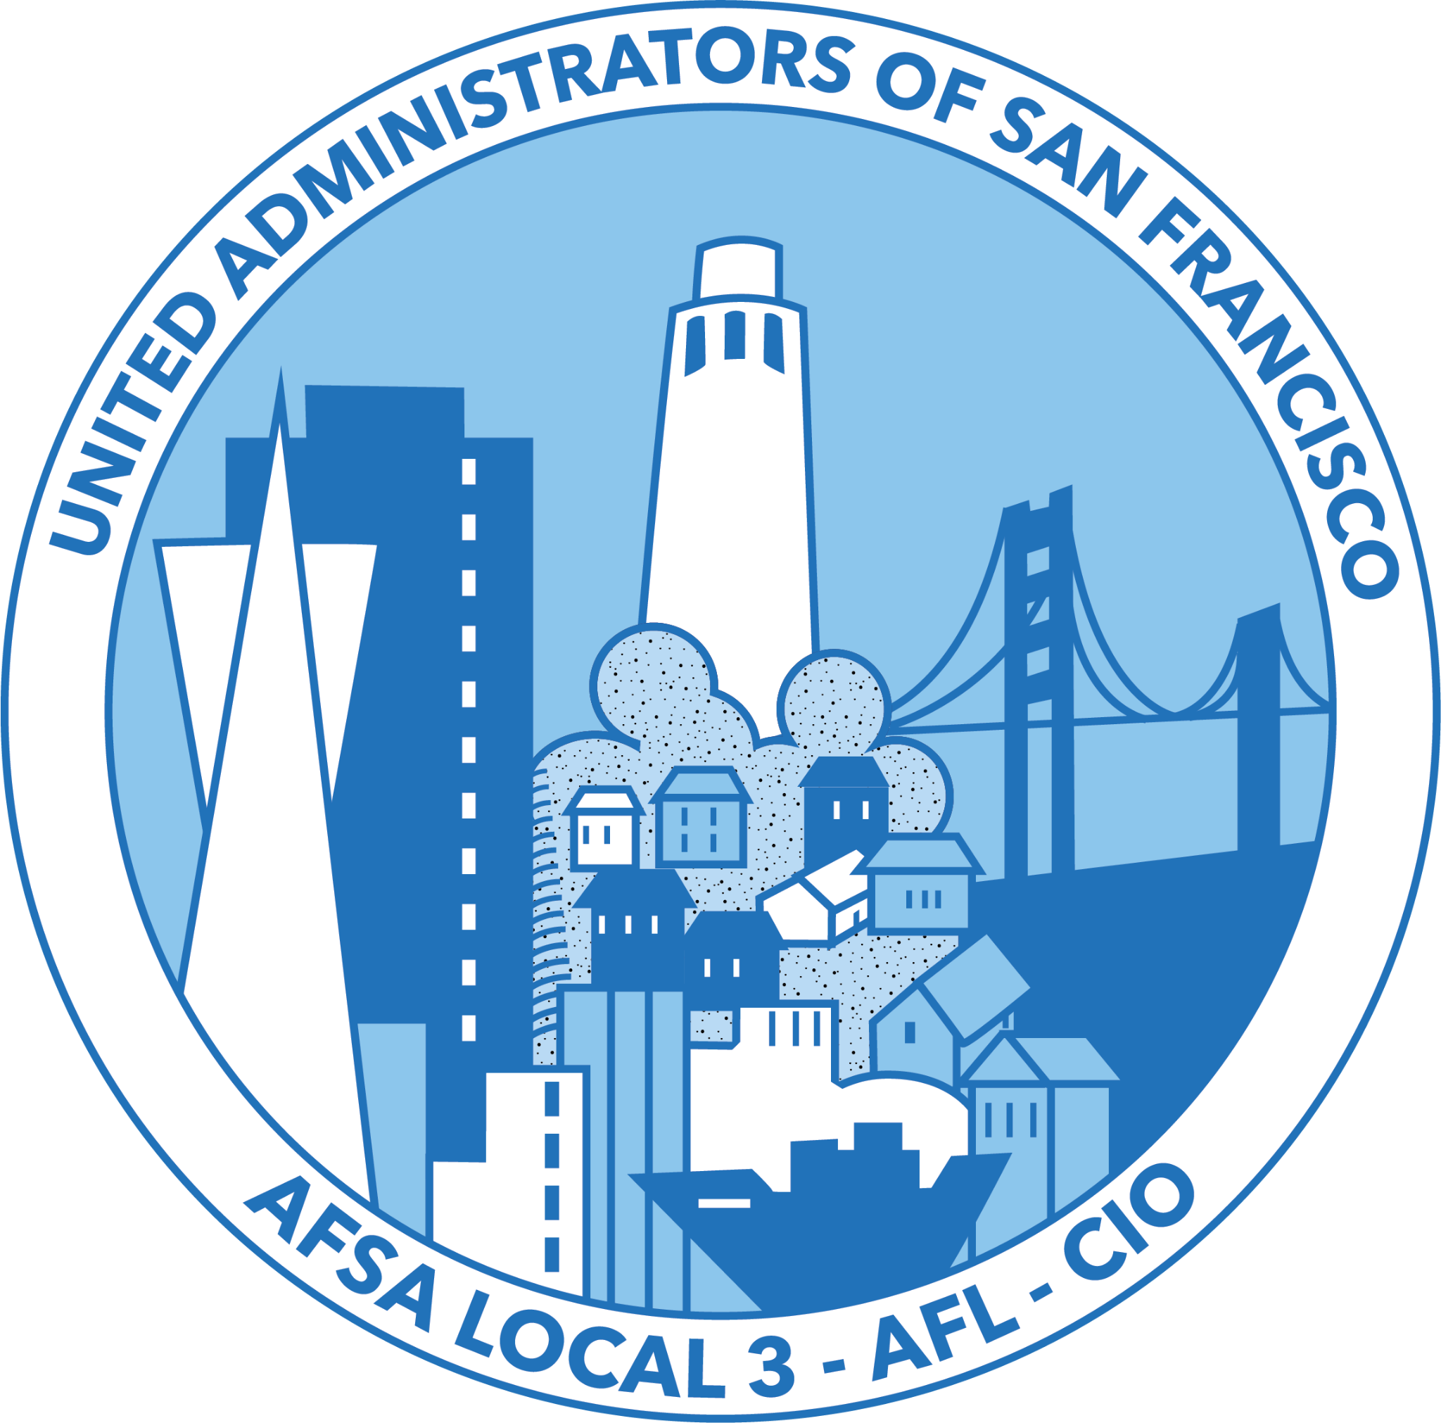
How to Work with Your Teachers Union and the Central Labor Council
July 20, 2026
AFSA Summer Learning Institute
Presenter: Ellen Wong, United Administrators of San Francisco (UASF)

Slide 2
THE UASF LANDSCAPE

Slide 3
AFFILIATIONS
National: AFSA Local 3
State: California Labor Federation
California Association of Urban School Administrators
Local: San Francisco Labor Council

Slide 4
UNIONS OF SAN FRANCISCO UNIFIED (SFUSD)
6,500 United Educators of SF (UESF) AFT/CFT #61
Certificated
Classified
1,100 SEIU Local 1021
260 UASF AFSA Local 3
Certificated
75 IFPTE Local 21
60 Common Crafts (SF Bldg and Construction Trades Council)
10 IBEW Local 6
10 IUOE Local 39

Slide 5
SAN FRANCISCO UNIFIED SCHOOL DISTRICT (SFUSD) - CITY & COUNTY
Participates in the San Francisco Health Service System
Clerks are civil service
Except for UASF and UESF, all other Unions of SFUSD represent members who work for the City, the Airport, and the Community College
Community Schools Coordinators are members of SEIU Local 1021
Receive significant funding from the City

Slide 6
SAN FRANCISCO LABOR COUNCIL
The local body of the AFL-CIO
Represents over 150 affiliated unions
Represents over 100,000 union member and families
Reviews strike sanction requests and issues approvals
An authorized sanction asks other unions and laborers to respect the picket line and not cross it.
Holds monthly meetings

Slide 7
FOUR MAJOR SHIFTS

Slide 8
MAJOR SHIFT 1: THE PANDEMIC
The last day of in-person school for SFUSD students was on Friday, March 13, 2020
Full return to in-person school in the 2021-2022 school year

Slide 9
MAJOR SHIFT 2: SFLC & THE UNIONS OF SFUSD
The SFLC coordinated bi-weekly meetings of all the unions of SFUSD to discuss Health and Safety during the pandemic
Negotiated MOU’s on behalf of the Unions of SFUSD during the pandemic
The bi-weekly meetings have been ongoing
Facilitated meetings between the Unions of SFUSD with the District regarding demands for the school bond on the 2024 ballot

Slide 10
MAJOR SHIFT 3: THE EMPOWER DEBACLE
In January of 2022, the District launched a new payroll system resulting in:
Widespread payroll errors
In March UESF members occupied the District headquarters for three nights in protest of a severe payroll system failure that left over 1,000 teachers with missing or partial paychecks
Certificated employees pay into the California State Teachers Retirement System - there are still unresolved service credit issues for the 2021-2022 school year
The District switched to Frontline on July 1, 2025

Slide 11
MAJOR SHIFT 4: USAF LEADERSHIP
Current officers were elected in the 2024-2025 school year, and are in office through the 2026-2027 school year
More hands on
Participating in negotiations
Attending bi-weekly Unions of SFUSD meetings
Attending monthly SFLC meetings
Attending monthly Contract Administration Committee meetings with HR and Labor Relations

Slide 12
WORKING WITH SFLC

Slide 13
SHIFTS IN HOW UASF PARTICIPATES
Officers attend monthly SFLC meetings
Officers attend SFLC labor breakfast events that are held several times throughout the year (except during spring break)
SFLC announcements are included on our weekly newsletter
SFLC hosted candidates forum for recent Board of Education special election for the Unions of SFUSD
President attends bi-weekly Unions of SFUSD meetings

Slide 14
WORKING WITH THE TEACHERS UNION

Slide 15
SHIFTS IN HOW UASF WORKS WITH UESF
Dialogue between the presidents
Bargaining: transparent, big, and open bargaining (training by UC Berkeley Labor Center)
Encourage principals to reach out to UESF for support regarding how to work with the UBC
Signed off on side letters for salary placement
Participate in their labor actions and rallies
Hold a sympathy strike

Slide 16
REFLECTION

Slide 17
Q & A

Slide 18
LINKS
SFUSD Labor Partners - find links to contracts
CTA: We Can’t Wait Coordinated Bargaining

